Slide 1
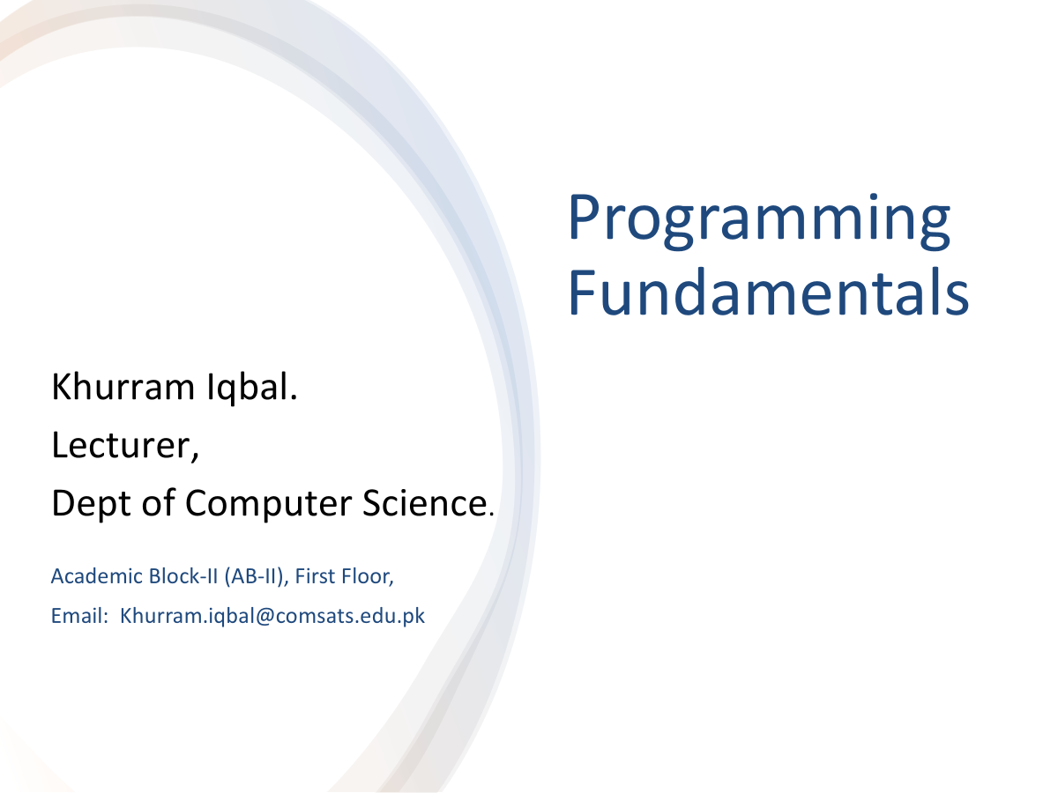

Slide 2
Lecture Outline Conditionals
Introduction: Control flow
Boolean Types, Values, and Expressions
One-way if statement
Two-way if-else statement

Slide 3
Introduction
Control structure: logical design that controls order in which set of statements execute
Sequence structure: set of statements that execute in the order they appear
Decision structure: specific action(s) performed only if a condition exists
Also known as selection structure

Slide 4
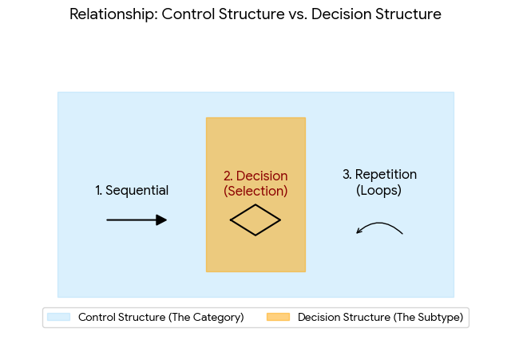

Slide 5
Conditionals
Control flow
The sequence of statements that are actually executed in a program.
Conditionals and loops enable us to choreograph control flow.
statement 1
true
boolean 1
false
statement 2
statement 1
boolean 2
true
statement 2
statement 3
false
statement 4
statement 3
straight-line control flow
[ previous lecture ]
control flow with conditionals and a loop
[this lecture]

Slide 6
Introduction
import java.util.Scanner;
public class ComputeArea{
public static void main(String[] args){
// Create a Scanner object
Scanner input = new Scanner(System.in);
// Prompt the user to enter a radius
System.out.println("Enter the radius of Circle");
double radius = input.nextDouble();
// Compute area
double area = 3.14159 * radius * radius;
// Display results
System.out.print("The area of Circle is: "+area);
}

Slide 7
Boolean Types, Values, and Expressions
Selection statements use conditions, which are Boolean expressions.
A Boolean expression is an expression that evaluates to a Boolean value True or False.
JAVA provides six comparison operators (also known as relational operators)

Slide 8
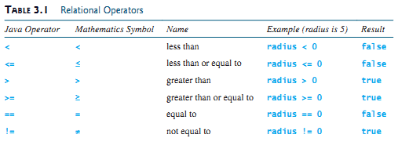
Relational Operators

Slide 9
boolean Data Type
The boolean data type declares a variable with the value either true or false
A variable that holds a Boolean value (True/False) is known as a Boolean variable.
E.g. boolean lightsOn = true
true and false are reserve words

Slide 10
The if statement
Execute certain statements depending on the values of certain variables.
Evaluate a boolean expression.
If true, execute a statement.
The else option: If false, execute a different statement.
Example: if (x < 0) x = -x;
Example: if (x > y) max = x;
else max = y;
true
x < 0 ?
false
true
x > y ?
false
x = -x;
max = x;
max = y;
Replaces x with the absolute value of x
Computes the maximum of x and y

Slide 11
Issues in sequential structures
import java.util.Scanner; // Scanner is in the java.util package
public class ComputeAreaWithConsoleInput {
public static void main(String[] args) {
// Create a Scanner object
Scanner input = new Scanner(System.in);
// Prompt the user to enter a radius
System.out.print("Enter a number for radius: ");
double radius = input.nextDouble(); //method in Scanner class
// Compute area
double area = radius * radius * 3.14159;
// Display results
System.out.println("The area for the circle of radius " + radius + " is " + area);
}
}

Slide 12
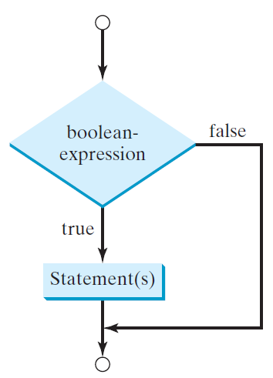
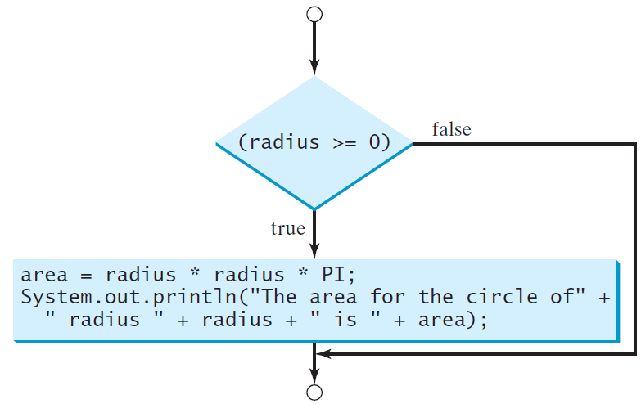
One-way if Statements
Syntax
if (radius >= 0) {
area = radius * radius * PI;
System.out.println("The area"
+ " for the circle of radius "
+ radius + " is " + area);
}
if (boolean-expression) {
statement(s);
}

Slide 13
Note
The boolean-expression is enclosed in parentheses. For example, the code in (a) is
wrong. It should be corrected
The block braces can be omitted if they enclose a single statement. For example, the following statements are equivalent.

Slide 14



Example of if statement use: simulate a coin flip
public class Flip
{
public static void main(String[] args)
{
if (Math.random() < 0.5) System.out.println("Heads");
else
System.out.println("Tails");
}
}
% java Flip Heads
% java Flip Heads
% java Flip Tails
% java Flip Heads

Slide 15


Example of if statement use: 2-sort
Q. What does this program do?
public class TwoSort
{
public static void main(String[] args)
{
int a = Integer.parseInt(args[0]); int b = Integer.parseInt(args[1]);
System.out.println(a); System.out.println(b);
}
}
if (b < a)
{
int t = a;
a = b;
b = t;
}
% java TwoSort 1234 99
99
1234
% java TwoSort 99 1234
99
1234
alternatives for if and else can be a sequence of
statements, enclosed in braces
A. Reads two integers from the command line, then prints them out in numerical order.

Slide 16

Example of if statement use: error checks
public class IntOps
{
public static void main(String[] args)
{
int a = Integer.parseInt(args[0]); int b = Integer.parseInt(args[1]); int sum = a + b;
int prod = a * b;
System.out.println(a + " + " + b + " = " + sum); System.out.println(a + " * " + b + " = " + prod);
if (b == 0) System.out.println("Division by zero");
else System.out.println(a + " % " + b + " = " + a % b);
}
}
% java IntOps 5 2
5 | + | 2 | = | 7
5 | * | 2 | = | 10
5 | / | 2 | = | 2
5 | % | 2 | = | 1
% java IntOps 5 0
5 + 0 = 5
5 * 0 = 0
Division by zero Division by zero
if (b == 0) System.out.println("Division by zero");
else System.out.println(a + " / " + b + " = " + a / b);
Good programming practice. Use conditionals to check for and avoid runtime errors.

Slide 17
int time = 2, tide = 3;
if (time + tide > 6)
System.out.println("Time and tide wait for no one.");
else
System.out.println("Time and tide wait for me.");
Write an if statement that increases pay by 3% if score is greater than 90
Write an if statement that assigns 1 to x if y is greater than 0.
Write an if statement that increases pay by 3% if score is greater than 90, other-wise increases pay by 1%.

Slide 18
Problem
Write a JAVA program that prompts the user to enter an integer. If the number is a multiple of 5, the program displays HiFive. If the number is divisible by 2, it displays HiEven

Slide 19
Solution
import java.util.Scanner;
public class Main {
public static void main(String[] args) {
// Create a Scanner object to read user input
Scanner scanner = new Scanner(System.in);
// Prompt the user to enter an integer
System.out.print("Enter an integer: ");
int number = scanner.nextInt();
// Check if the number is a multiple of 5
if (number % 5 == 0) {
System.out.println("HiFive");
}
// Check if the number is divisible by 2
if (number % 2 == 0) {
System.out.println("HiEven");
}
// Close the scanner
scanner.close();
}
}

Slide 20


Pop quiz on if statements
Q. Add code to this program that puts a, b, and c in numerical order.
public class ThreeSort
{
public static void main(String[] args)
{
int a = Integer.parseInt(args[0]); int b = Integer.parseInt(args[1]); int c = Integer.parseInt(args[2]);
System.out.println(a); System.out.println(b); System.out.println(c);
}
}
% java ThreeSort 1234 99 1
1
99
1234
% java ThreeSort 99 1 1234
1
99
1234

Slide 21


Pop quiz on if statements
Q. Add code to this program that puts a, b, and c in numerical order.
public class ThreeSort
{
public static void main(String[] args)
{
int a = Integer.parseInt(args[0]); int b = Integer.parseInt(args[1]); int c = Integer.parseInt(args[2]); if (b < a)
{ int t = a; a = b; b = t; } if (c < a)
{ int t = a; a = c; c = t; } if (c < b)
{ int t = b; b = c; c = t; } System.out.println(a); System.out.println(b); System.out.println(c);
% java ThreeSort 1234 99 1
1
99
1234
% java ThreeSort 99 1 1234
1
99
1234
A.
makes a smaller than b
makes a smaller than both b and c
makes b smaller than c
}
}

Slide 22
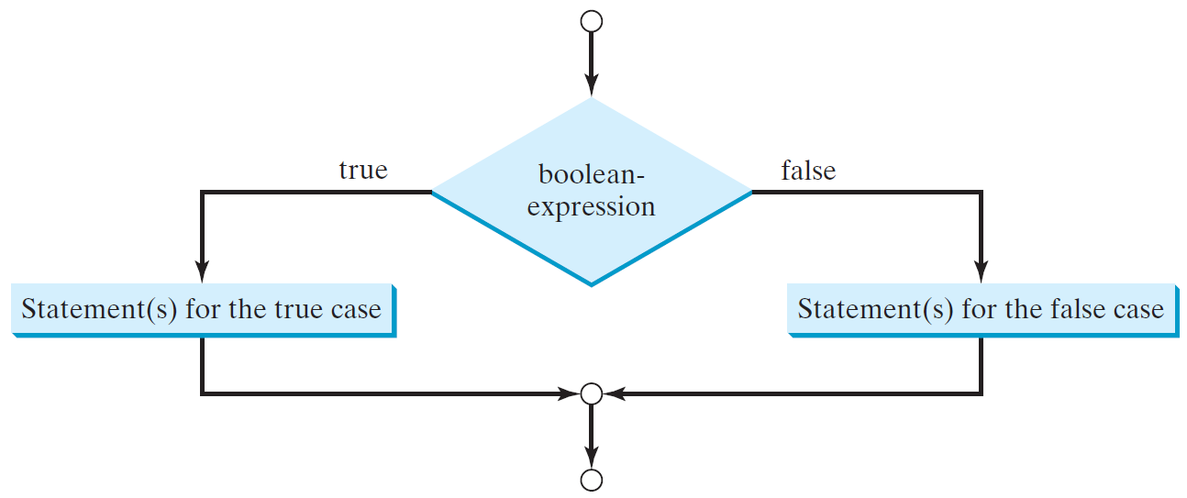
The Two-way if Statement
An if-else statement decides the execution path based on whether the condition is true or false
if (boolean-expression) {
statement(s)-for-the-true-case;
}
else {
statement(s)-for-the-false-case;
}

Slide 23
if-else Example
if (radius >= 0) {
area = radius * radius * 3.14159;
System.out.println("The area for the “
+ “circle of radius " + radius +
" is " + area);
}
else {
System.out.println("Negative input");
}

Slide 24
Problem
Chris owns an auto repair business and has several employees. If an employee works over 40 hours in a week, Chris pays that employee 1.5 times his or her regular hourly pay rate for all hours over 40. Chris has asked you to design a simple payroll program that calculates an employee’s gross pay, including any overtime wages.
Algorithm
1. Get the number of hours worked.
2. Get the hourly pay rate.
3. If the employee worked more than 40 hours, calculate the gross pay with over-time. Otherwise, calculate the gross pay as usual.
4. Display the gross pay.

Slide 25
import java.util.Scanner;
public class GrossPayCalculator {
public static void main(String[] args) {
Scanner scanner = new Scanner(System.in);
System.out.print("Enter the number of hours worked: ");
double hoursWorked = scanner.nextDouble();
System.out.print("Enter the hourly pay rate: ");
double hourlyRate = scanner.nextDouble();
double grossPay;
double overtimeRate = 1.5;
double regularHours = 40.0;
if (hoursWorked > regularHours) {
double overtimeHours = hoursWorked - regularHours;
grossPay = (regularHours * hourlyRate) + (overtimeHours * hourlyRate * overtimeRate);
} else {
grossPay = hoursWorked * hourlyRate;
}
System.out.printf("The gross pay is: $%.2f", grossPay);
scanner.close();
}
}

Slide 26
Summary
Boolean Expression
Conditional Statements

Slide 27
Next Lecture
Nested if statement
Multi-way if-else if-else statement
Logical Operators
Conditional expressions

